Slide 1

CASE ANALYSIS:
MANAGING CROSS-CULTURAL VIRTUAL COLLABORATION
Understanding time management and collaboration issues in global teams
PRESENTED BY ADITYA & ADITYA RAJ

Slide 2

The problem?
Mismatch in meeting punctuality and expectations
Leads to:
Wasted meeting time
Miscommunication
Lower productivity
Bad working relationships

Slide 3
Why the problem??

Slide 4
1. Cultural time orientation
2. Work Style Differences
Middle Eastern Teams
U.S. Teams
Middle Eastern Teams
U.S. Teams
Monochronic culture, focuses on
Schedule
Deadlines
Punctuality
Polychronic culture, focuses on
Flexibility
Relationships
Familial relations
Tasks and deadlines
Focused
Relationships
Focused

Slide 5
1. Cultural time orientation
2. Work Style Differences
3. Virtual Collaboration Gaps
Middle Eastern Teams
Middle Eastern Teams
U.S. Teams
U.S. Teams
No shared meeting norms
Time zone and weekend mismatches
Inconsistent communication about schedule changes
Monochronic culture, focuses on
Schedule
Deadlines
Punctuality
Polychronic culture, focuses on
Flexibility
Relationships
Familial relations
Tasks and deadlines
Focused
Relationships
Focused

Slide 6
2. Work Style Differences
3. Virtual Collaboration Gaps
Middle Eastern Teams
U.S. Teams
No shared meeting norms
Time zone and weekend mismatches
Inconsistent communication about schedule changes
Tasks and deadlines
Focused
Relationships
Focused

Slide 7
Chronemics refers to how different cultures perceive & manage time in communication

Slide 8
D
C
A
B
TECHNICAL TOOLS AND REMINDERS
CULTURAL AWARENESS TRAINING
SHARED OPERATIONS PROTOCOL
FELXIBLE SCHEDULING
POSSIBLE SOLUTIONS
USE AUTOMATED REMINDERS AND MEETING DASHBOARDS
INTEGRATE WITH MODERN TOOLS LIKE TEAMS, SLACK, ASANA
CONDUCT BREIF WORKSHOPS FOR BOTH TEAMS
BUILD EMPATHY & UNDERSTANDING OF DIFFERENT TIME PERCEPTIONS
ALTERNATE MEETING TIME FOR FAIRNESS
RECORD AND SUMMARIZE MEETINGS FOR ABSENTEES
CREATE JOINT MEETING POLICY (PUNCTUALITY, DELAY LIMITS, RESCHEDULE RULES)
USE SHARED TIME-ZONE AWARE CALENDARS

Slide 9
A
B
C
D
SHARED OPERATIONS PROTOCOL
CULTURAL AWARENESS TRAINING
FELXIBLE SCHEDULING
TECHNICAL TOOLS AND REMINDERS
POSSIBLE SOLUTIONS
CREATE JOINT MEETING POLICY (PUNCTUALITY, DELAY LIMITS, RESCHEDULE RULES)
USE SHARED TIME-ZONE AWARE CALENDARS
CONDUCT BREIF WORKSHOPS FOR BOTH TEAMS
BUILD EMPATHY & UNDERSTANDING OF DIFFERENT TIME PERCEPTIONS
ALTERNATE MEETING TIME FOR FAIRNESS
RECORD AND SUMMARIZE MEETINGS FOR ABSENTEES
USE AUTOMATED REMINDERS AND MEETING DASHBOARDS
INTEGRATE WITH MODERN TOOLS LIKE TEAMS, SLACK, ASANA

Slide 10

an ENGINEER’S PERSPECTIVE
I
II
Analyze the system, not the people
Identify root causes
Find why delay happens before suggesting fixes
Focus on better system design, rather than blaming cultural habits
III
IV
Design adaptive processes
Optimize for efficiency & harmony
Build flexible systems that work across time zones and cultures
Balance punctuality with respect for diverse work styles

Slide 11





CONCLUSION
Global collaboration works best when engineered with structure and empathy.
Cultural diversity should be treated as a strength, not a barrier.
Building clear systems and shared norms bridges time and communication gaps.
Result → Efficient teamwork, mutual respect, and stronger partnerships.

Slide 12
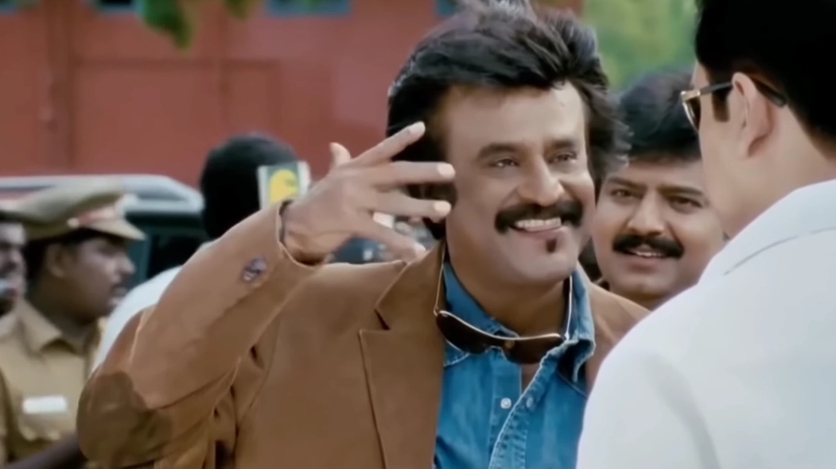
Thank you very much!

